Slide 1

Setting up Qt on Your Laptop: A Step-by-Step Guide
Qt is a versatile cross-platform application development framework, allowing you to craft desktop, mobile, and embedded applications from a single codebase. Whether you opt for its open-source or commercial licensing, Qt offers a powerful toolkit for creating feature-rich and visually appealing software. This guide walks you through setting up Qt on your laptop to start your development journey smoothly.
by taqi hikmat

Slide 2

Prerequisites: Software You'll Need
Operating System
IDE/Text Editor
Qt supports Windows (7+), macOS (10.13+), and various Linux distributions. Ensure your OS meets the minimum requirements.
Qt Creator is recommended, but Visual Studio or your preferred text editor can also be used for coding.
Compiler
GCC (Linux), MSVC (Windows), or Clang (macOS) are necessary for compiling your Qt applications. These are often bundled with Qt.

Slide 3
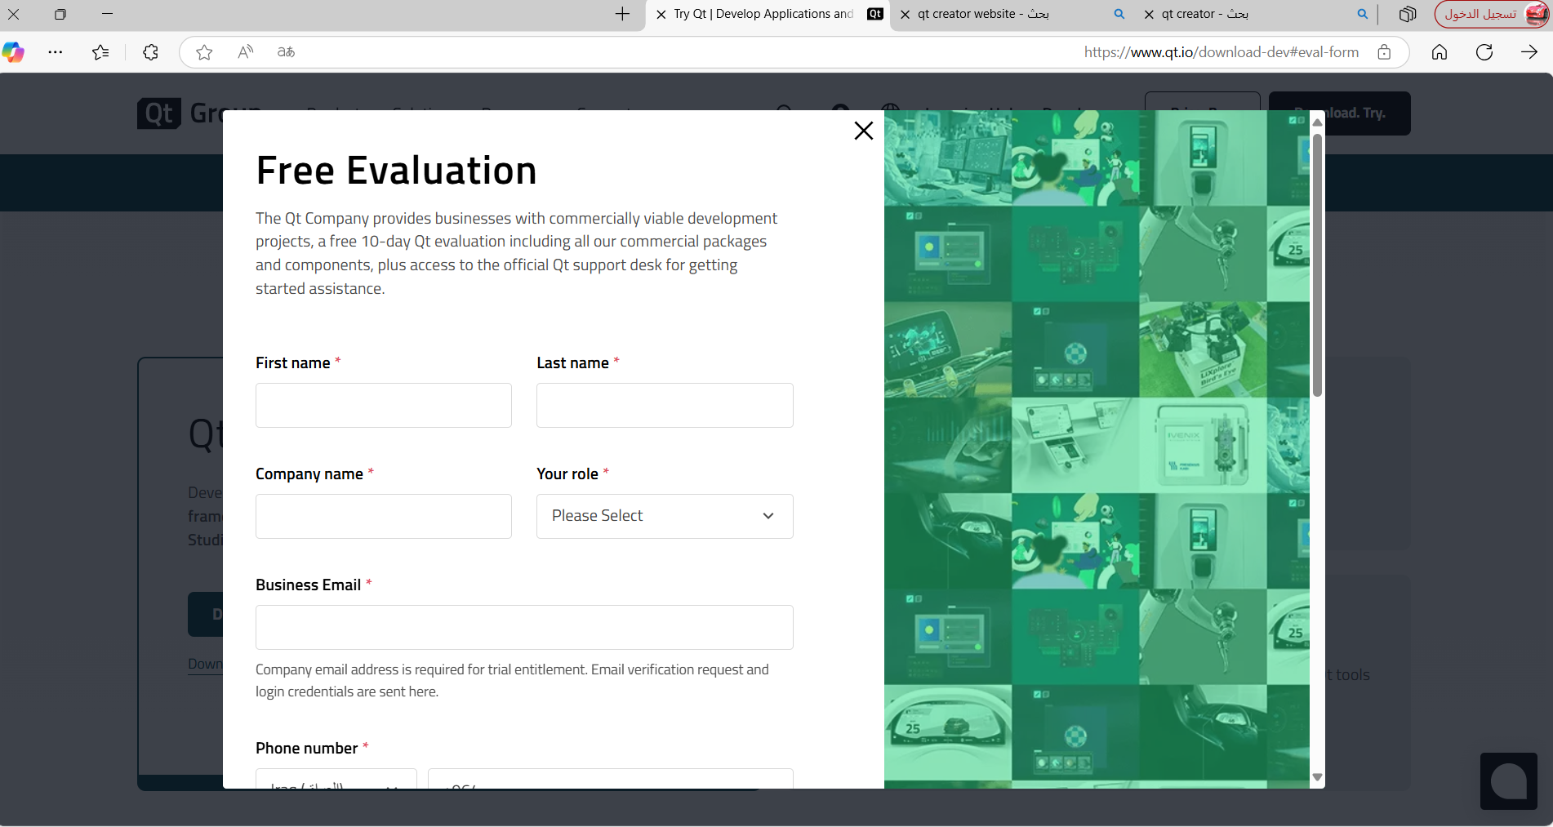
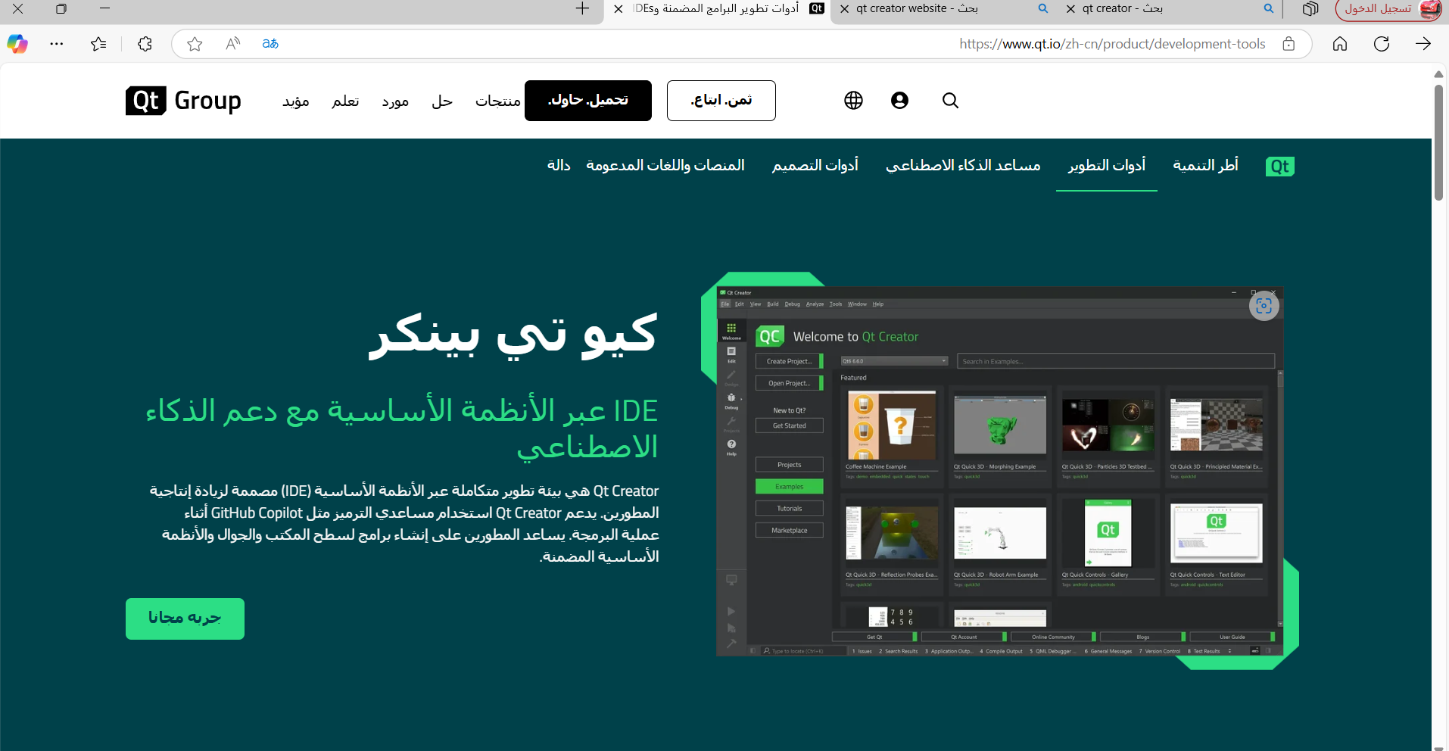
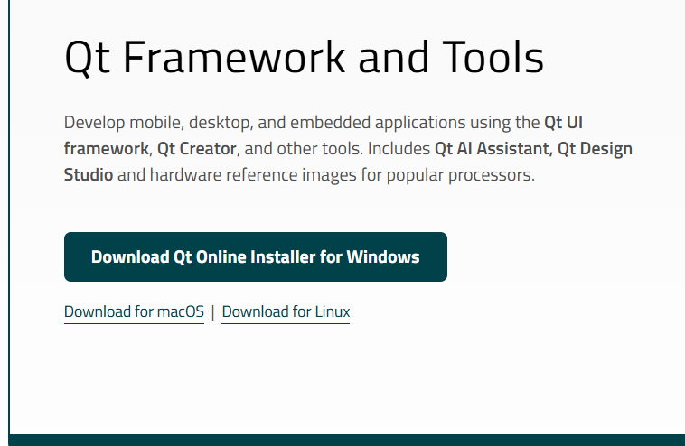
Step 1: Download the Qt Installer
Visit Qt Website
Choose Your Installer
Qt Account
Navigate to the official Qt website by typing qt.io/download in your browser.
Select the installer tailored to your operating system to ensure compatibility.
Be prepared to create a Qt account if you don't have one already, as it's often required for downloading the installer.

Slide 4

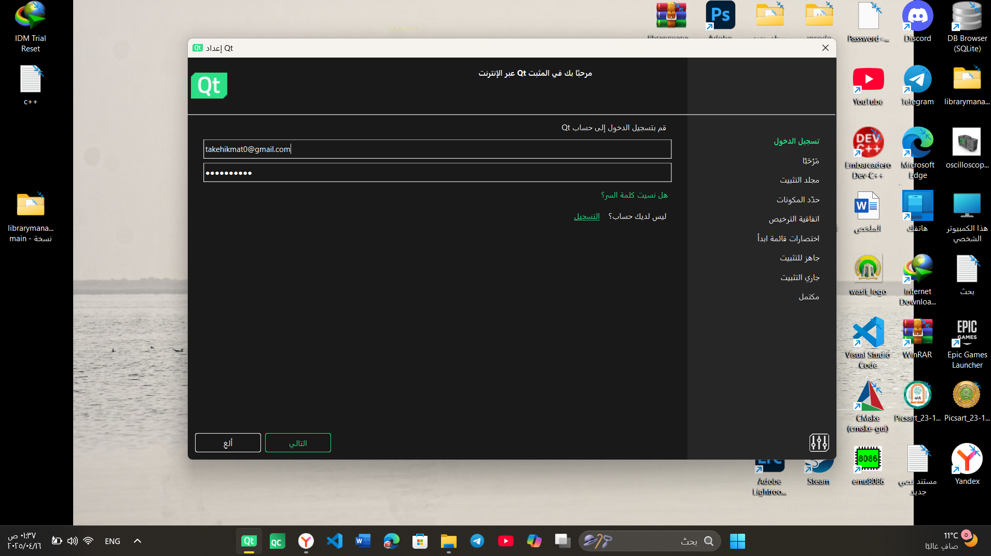

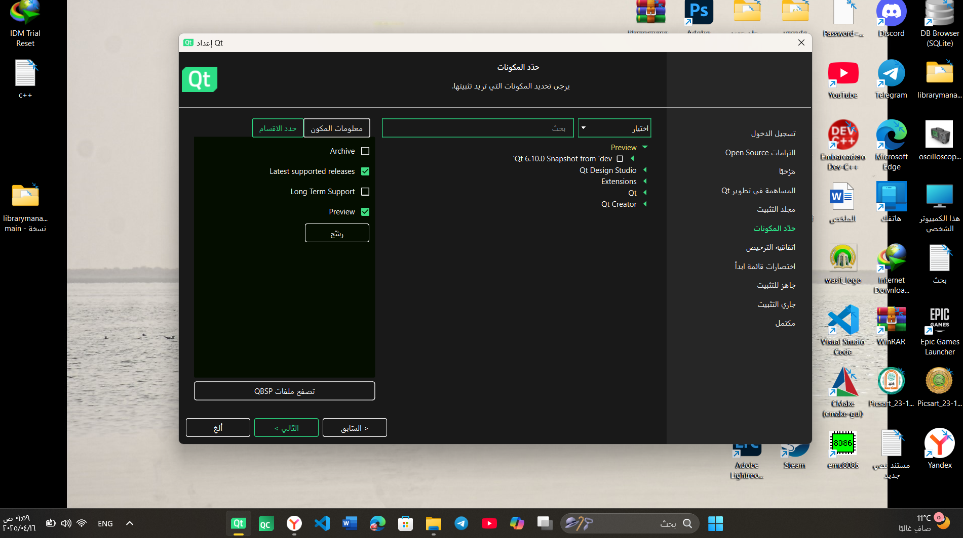

Step 2: Run the Qt Installer
Sign In
Use your Qt account credentials to log in.
Select Version
Choose the Qt version you wish to install (e.g., Qt 6.x).
Choose Components
Pick Qt libraries, Qt Creator, and essential tools. Consider including Qt Design Studio for UI design.

Slide 5
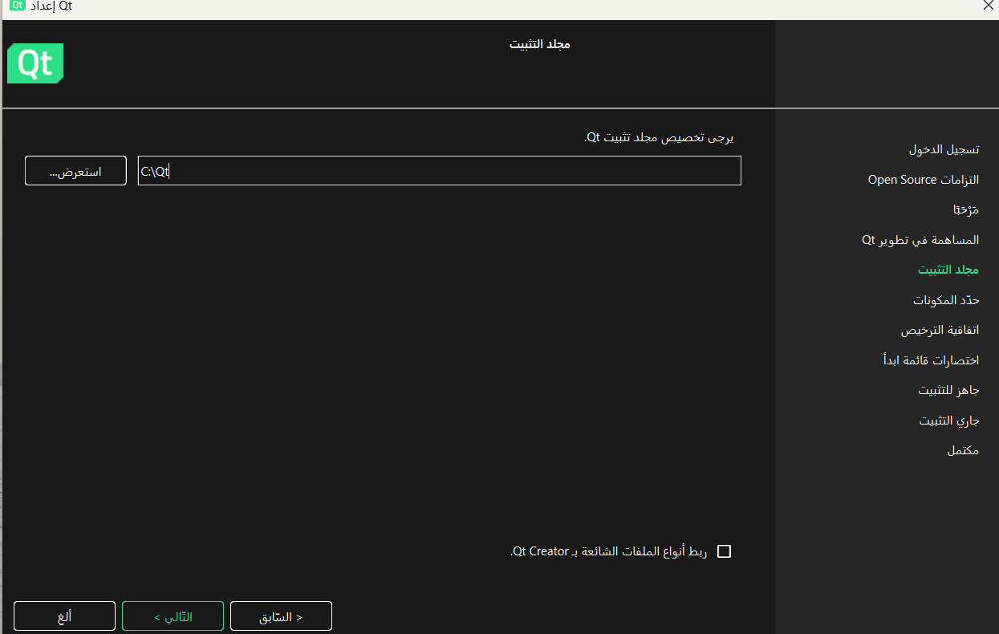

Step 3: Configure Installation Settings
1
Installation Directory
Choose where Qt will be installed (e.g., C:\Qt\6.7.0).
2
Select Compilers
Choose the compilers you want to use (e.g., MinGW for Windows).
3
Accept License
Agree to the license terms and start the installation.
4
Installation Time
Be patient, the process may take 30-60 minutes.
mingw

Slide 6
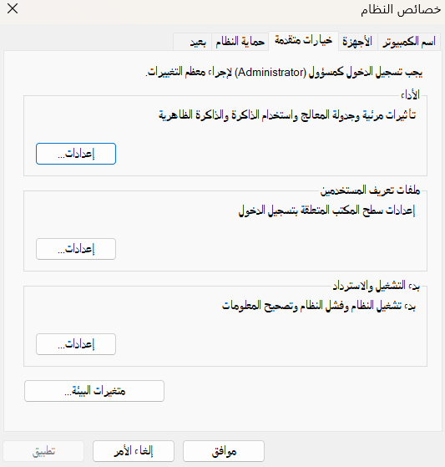


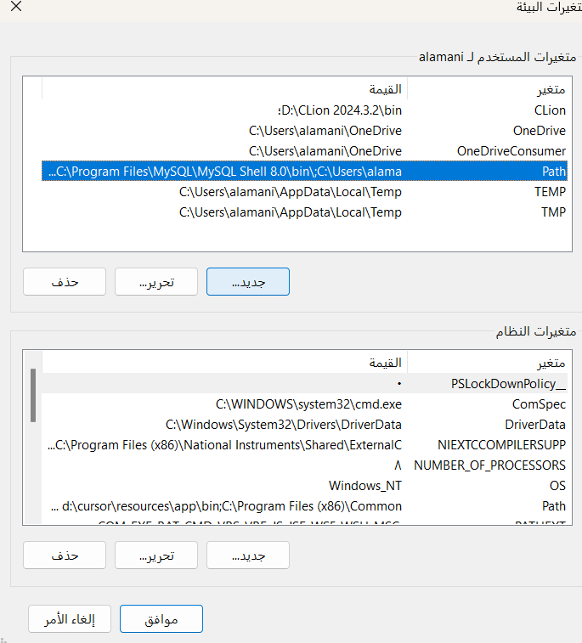


Step 4: Set Up Environment Variables (Windows)
Open System Properties
Navigate through Control Panel -> System and Security -> System to access system settings.
Advanced Settings
Click "Advanced system settings" in the System window.
Environment Variables
Open the "Environment Variables..." window to configure system-wide settings.
Edit "Path" Variable
Add the Qt bin directory (e.g., C:\Qt\6.7.0\mingw_64\bin) to your system's "Path" variable.

Slide 7



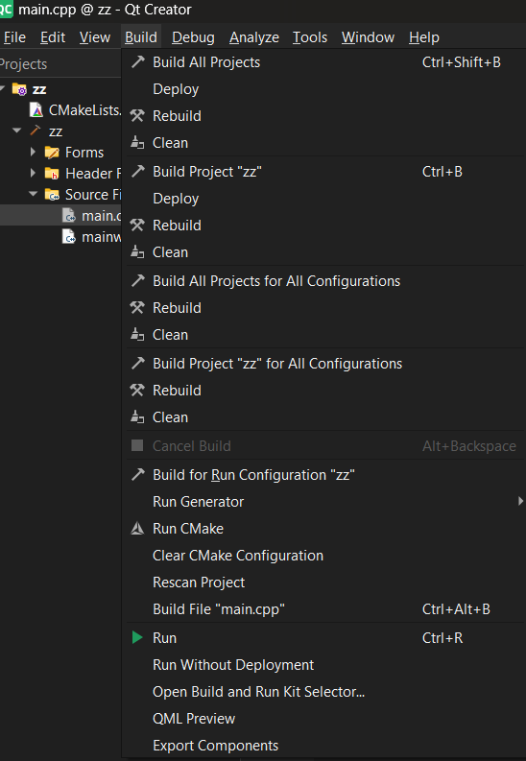
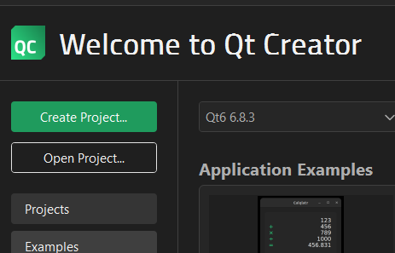
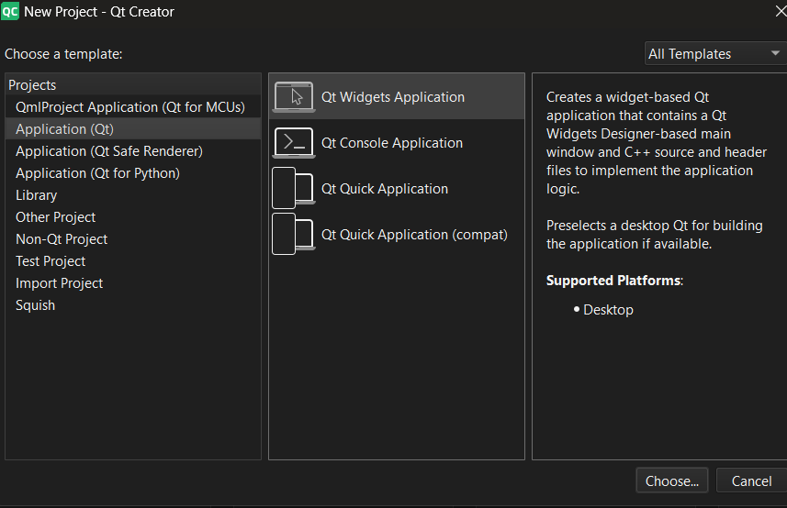
Step 5: Test Your Installation
Launch Qt Creator
1
Open the Qt Creator IDE.
Create Project
2
Start a new Qt Widgets Application project.
Build and Run
3
Build and execute the default application.

Slide 8

Troubleshooting and Resources
Common Issues
Qt Documentation
Watch out for "Compiler not found" errors or missing library issues, and double-check your setup.
The official documentation at doc.qt.io is an invaluable resource.
Qt Forums
Join the Qt community on the forums at forum.qt.io to ask questions and share knowledge.

